Slide 1


Video
Class 7
Lab 23

Slide 2

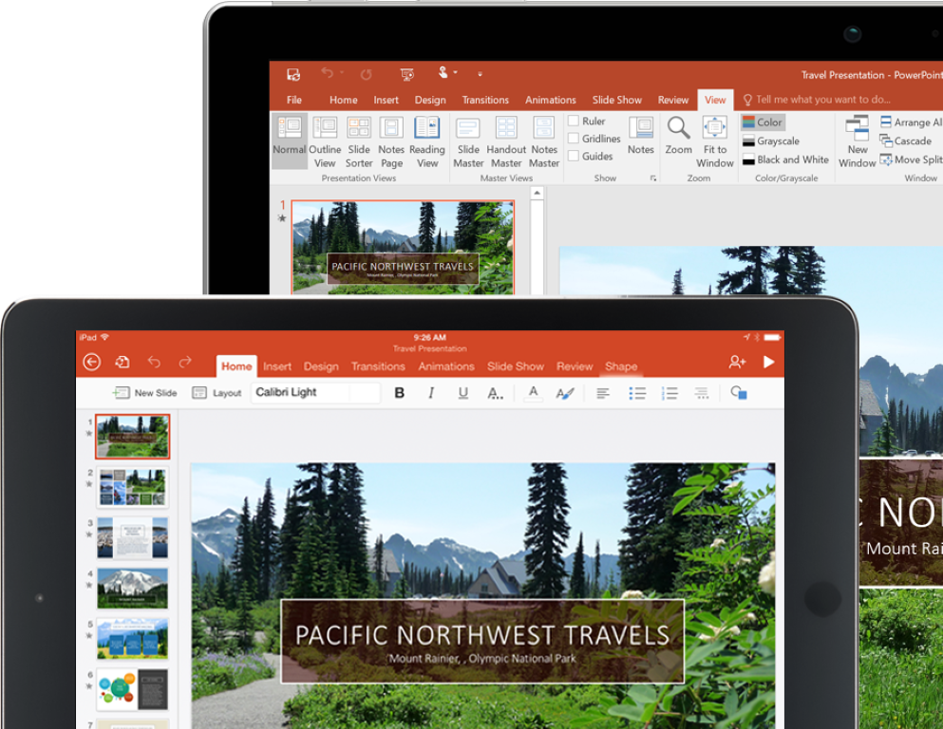
Microsoft PowerPoint
MS PowerPoint is a presentation slide making tool
Notes:
Notes to presenter:
Description of what you learned in your own words on one side.
Include information about the topic
Details about the topic will also be helpful here.
Tell the story of your learning experience. Just like a story there should always be a beginning, middle and an end.
On the other side, you can add a graphic that provides evidence of what you learned.
Feel free to use more than one slide to reflect upon your process. It also helps to add some video of your process.

Slide 3
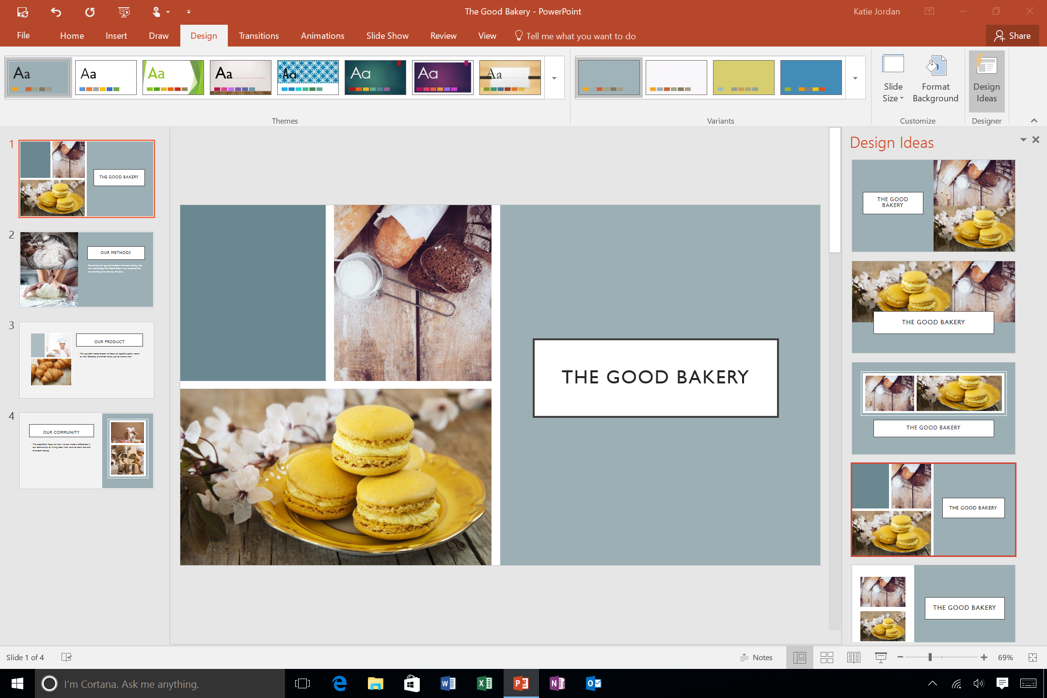
Microsoft PowerPoint
Previously we
used it for poster
Designing and Animation making
Notes:
Notes to presenter:
Description of what you learned in your own words on one side.
Include information about the topic
Details about the topic will also be helpful here.
Tell the story of your learning experience. Just like a story there should always be a beginning, middle and an end.
On the other side, you can add a graphic that provides evidence of what you learned.
Feel free to use more than one slide to reflect upon your process. It also helps to add some video of your process.

Slide 4

Microsoft PowerPoint
Today we will create intro video with PowerPoint
Notes:
Notes to presenter:
Description of what you learned in your own words on one side.
Include information about the topic
Details about the topic will also be helpful here.
Tell the story of your learning experience. Just like a story there should always be a beginning, middle and an end.
On the other side, you can add a graphic that provides evidence of what you learned.
Feel free to use more than one slide to reflect upon your process. It also helps to add some video of your process.

Slide 5
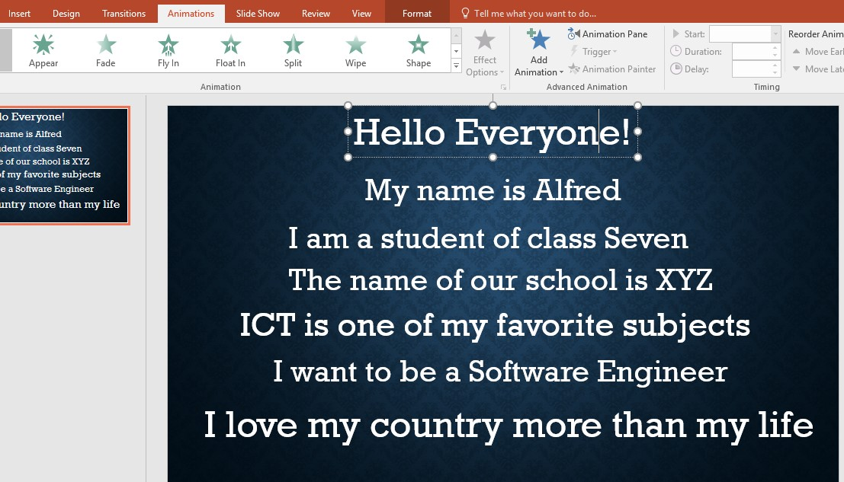
Intro Video
Change background
Select text box
and write about
Yourself
Add Float In animation
Notes:
Notes to presenter:
Description of what you learned in your own words on one side.
Include information about the topic
Details about the topic will also be helpful here.
Tell the story of your learning experience. Just like a story there should always be a beginning, middle and an end.
On the other side, you can add a graphic that provides evidence of what you learned.
Feel free to use more than one slide to reflect upon your process. It also helps to add some video of your process.

Slide 6
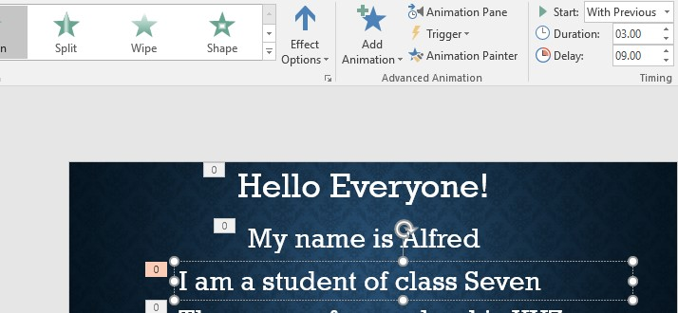
Intro Video
Correct the
duration
and delay for
every text box

Slide 7
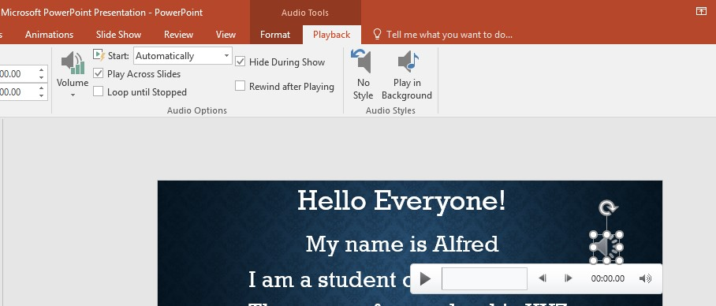
Intro Video
Add music and change the setting from playback option

Slide 8
Intro Video
Add music and change the setting from playback option

Slide 9
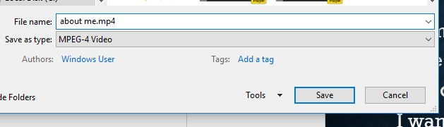
Intro Video
Render
file as
mp4
format

Slide 10

Here we go

Slide 11


